Slide 1
Life Insurance Capstone
Compiled by:
Thakur Arun Singh
January 2022

Slide 2
Business Problem Understanding
Introduction of the business problem –
The dataset belongs to a leading life insurance company. The company wants to predict the bonus for its agents so that it may design appropriate engagement activity for their high performing agents and up skill programs for low performing agents
Executive Summary
Understanding the business problem –
All Life Insurance companies offer various incentive plans for their employees, to boost their sales and to have higher balance of insurance plans, “The higher the Insurance amount the higher the bonus pay out”. However, not all companies get successful in the above Mantra. Some companies fail to have a better plan for bonus payouts. For such companies we should study the data and need to understand the requirements to implement the above plan. Where in, the company can predict the bonus for its employees and design appropriate engagement activity for their high performing employees and also have training programs for non/low performing employees.
The business environment - Life insurance sector in India,
There of service providers (24), premium collection (INR 7.3 trillion in FY 20)
Motivate agent for more sales, increase market share & profit and retaining agents.
Increasing awareness for life insurance, more lives getting insured.
Notes:
Academics and practitioners have studied over the years models for predicting firm’s various aspects, using statistical and machine-learning approaches. We are going to discuss one of the various aspects. An earlier sign that company employees are dissatisfied is the firm policies, work load, pay scale and bonuses. We are going to dive deeper and predict the bonus for its employees, so that we may designed an appropriate engagement activity for their high performing employees and up skill programs for low performing employees.

Slide 3
Modeling Approach Used and Why
The work that we have completed:
Merged data from various sources
Performed Data Quality and preparation activities
Performed EDA on the data to understand the dataset and to determine any outlier and treated the same
The purpose of Univariate Analysis is to find out which variables have clear separation for the target variable – separation of mean & median of continuation variables and their skewness impacted the targeted variable – Agent bonus
The purpose of Bivariate analysis is to establish the relationship among various independent variables and with dependent variables
Used ANNOVA to understand if the model performance can be improved and very significant test of variable through ANNOVA
Checked unbalance data
Model building and interpretation.
LDA & Kmeans are suited for classification problem
Model building approach (Multicollinearity – VIF, significant features & their selection process based on p-values & coefficient estimates etc.)
Model Tuning
Actionable business insights such as identification of features which are contributing to increase in bonus (e.g. sum assured)
Insights
Insights from models, one unit change of a significant feature resulting how much change in bonus.
Delta of coefficients from linear models. Likewise, feature importance of optimum model.
Specific recommendations to up skilling the low performing agents and incentivizing the high performing agents.
Notes:
Merged data from other sources such as, demographic information, account details etc. for further deep analysis
Data Quality and preparation activities were performed such as missing value treatment, imputation, data type conversions for homogeneity in the data set
Performed EDA on the data to understand the data and to determine any outlier and treatment for the same
The purpose of Univariate Analysis is to find out which variables have clear separation for the target variable – separation of mean & median of continuation variables and their skewness affecting the target variable – Agent bonus.
Bivariate analysis is to establish the relationship among various independent variables and with dependent variables.
Also used ANNOVA to understand if the model performance can be improved and very significance test of variable through ANNOVA
Checking unbalance data which is very critical to classification problem
Model building and interpretation.
Liner discrimination analysis & Kmeans are suited for classification problem
Model building approach (Multicollinearity – VIF, significant features & their selection process based on p-values & coefficient estimates etc.)
Model Tuning
Actionable business insights like identification of features which are contributing to increase in bonus (e.g. sum assured) so that company could focus on those features for up skilling agents.
Insights
Insights from models, one unit change of a significant feature resulting how much change in bonus. - Delta of coefficients from linear models. Likewise, feature importance of optimum model.
specific recommendations to up skilling the low performing agents and incentivizing the high performing agents.

Slide 4
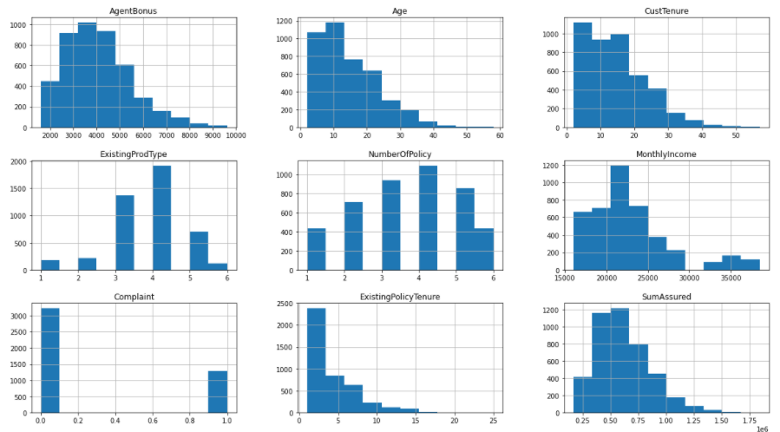
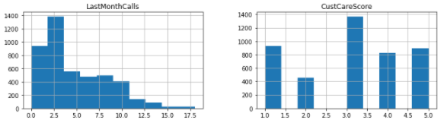
Exploratory Data Analysis
Agent Bonus: From the below graph we can see that the majority of the bonus falls between 3,000 to 4,000.
Below the graph shows that the average age of the Age: Customer is about 30-35 years.
Customer Tenure: Below graph shows that there are over 1000 customer who are loyal customers for at least 10 years.
Existing Product Type: Below graph shows that there at about 2000 people who hold at least 4 products
Number of Policies: Below graph shows that at least 1000 people hold 4 policies each.
Monthly Income: About 1200 people have a monthly income between 20,000 – 25,000.
Complaints: There were about 3000+ people who had complained between 0-1 times.
Existing Policy Tenure: There are about 2500 customer who took policies at least a year ago.
Sum Assured: The major count of the sum assured is between 400K and 600K
Last Month Calls: We have received at least 2 calls from nearly 1400 customers
Customer Care Score: Marjory of the customer lies between the Customer care score of 3 – 3.5.

Slide 5
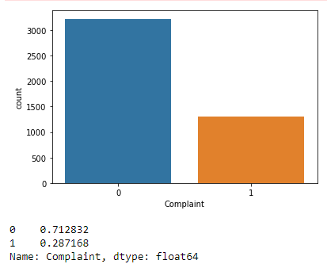
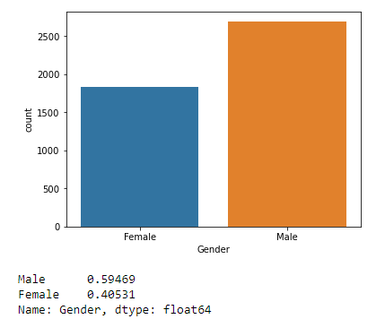
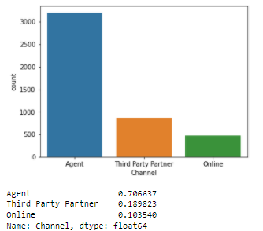
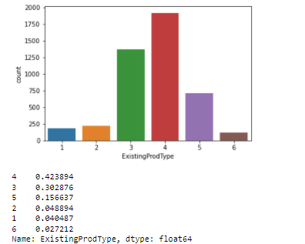
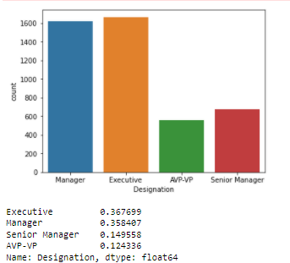
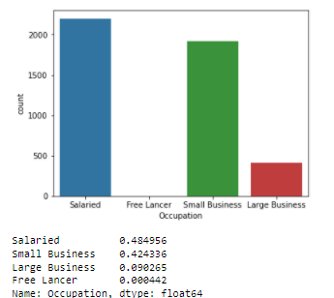
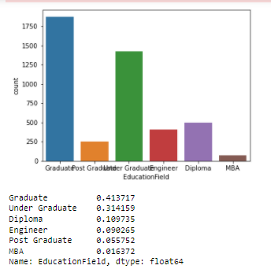
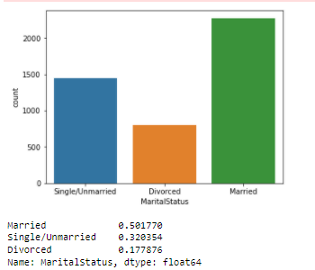
Exploratory Data Analysis

Slide 6
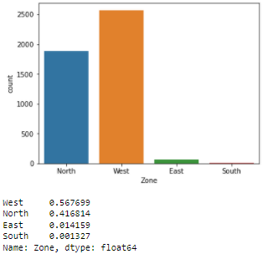
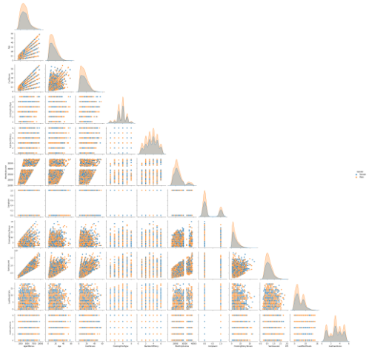
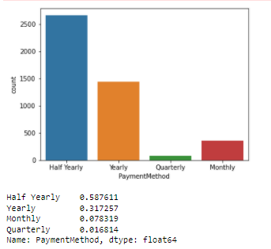
Exploratory Data Analysis

Slide 7
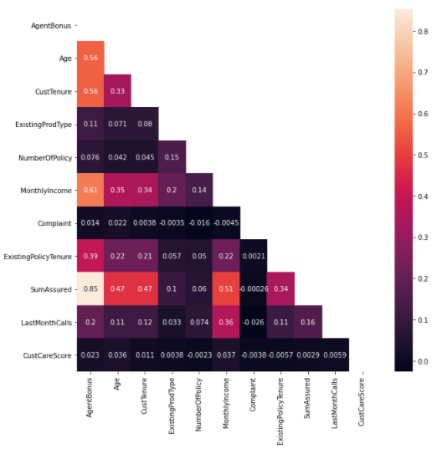
Exploratory Data Analysis
Top 5 strong correlations:
SumAssured & AgentBonus
MonthlyIncome & AgentBonus
CustTenure & AgentBonus
Age & AgentBonus
MonthlyIncome & SumAssured

Slide 8
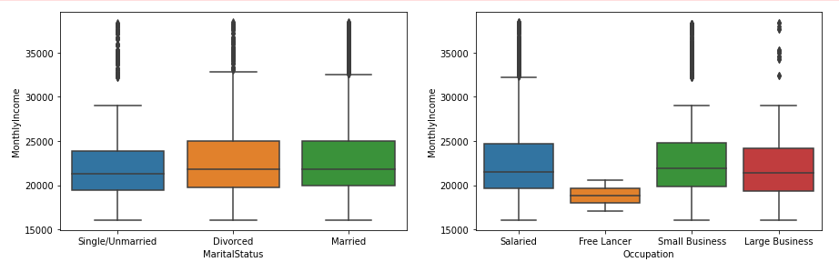
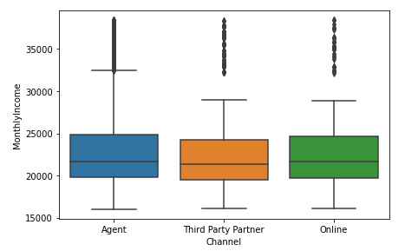
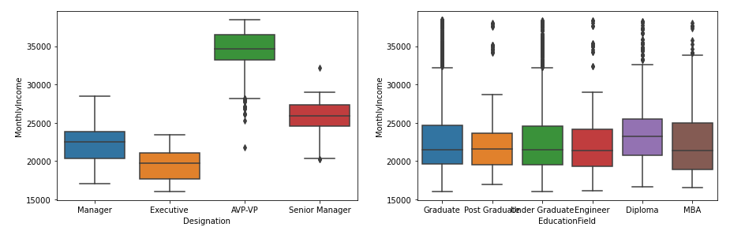
Exploratory Data Analysis
Below box plots shows relationship between MonthlyIncome & categorical variables
Customer Designation creates clear groups for MonthlyIncome of the customer so Missing Values in MonthlyIncome will be filled considering means of every group

Slide 9
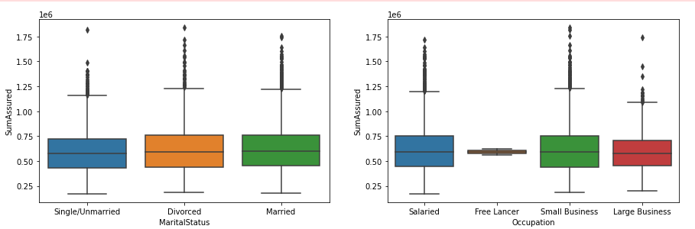
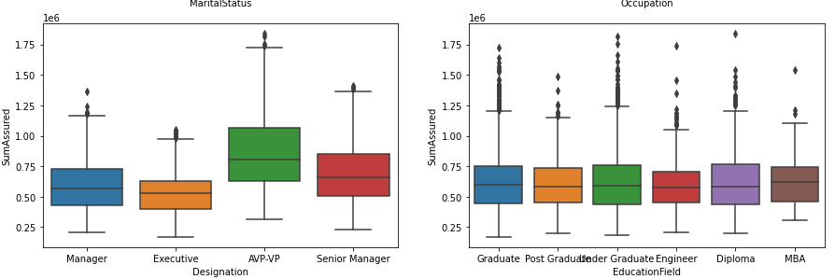
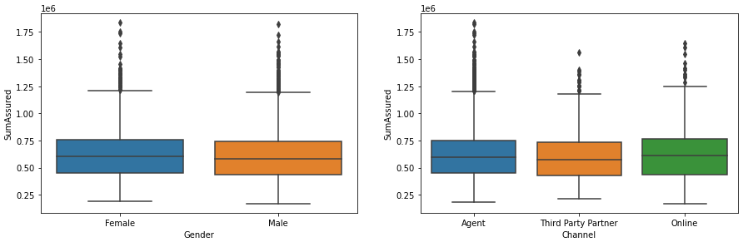
Exploratory Data Analysis
Below box plots shows relation between SumAssured & categorical variables

Slide 10
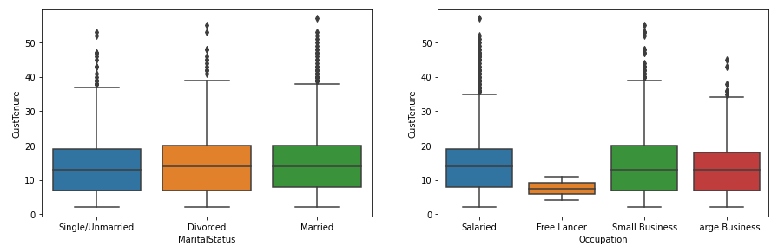
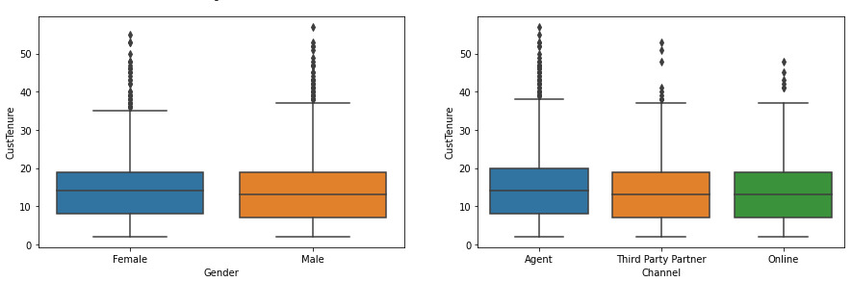
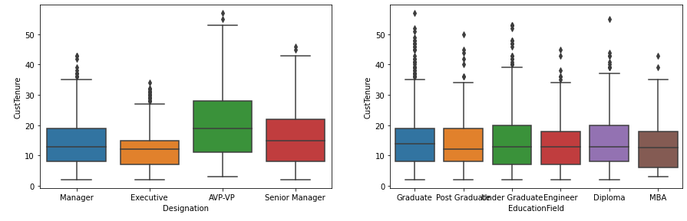
Exploratory Data Analysis
Below box plots shows the relationship between CustTenure & categorical variables

Slide 11
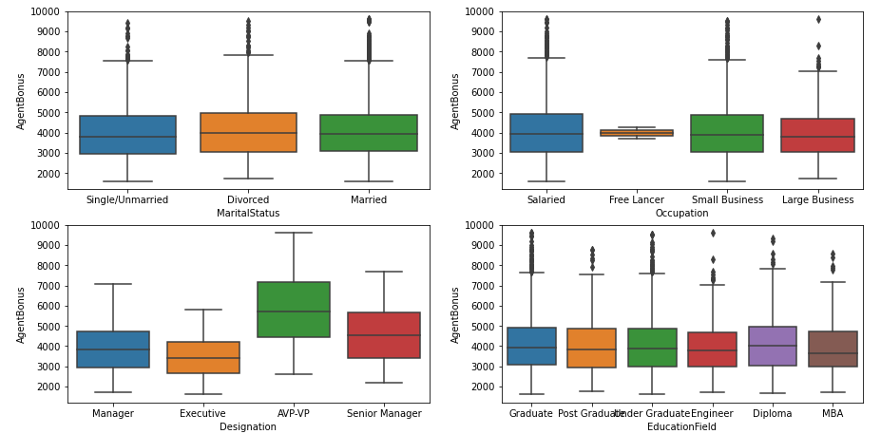
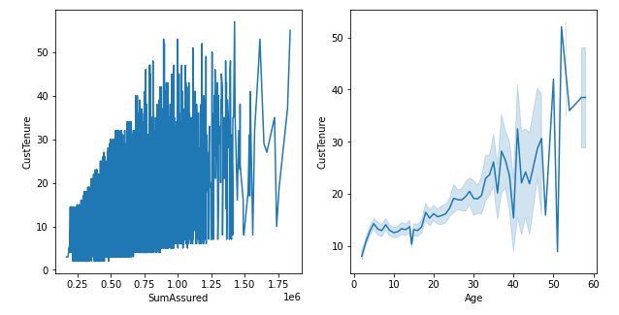
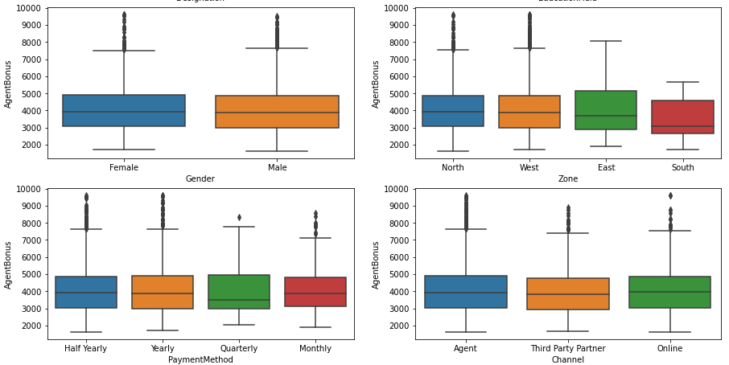
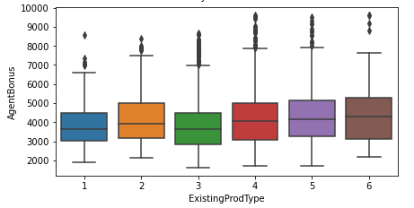
Exploratory Data Analysis
Below graphs shows the relationship between Customer tenure VS Sum Assured and age
Below Box plots shows relationship between AgentBonus & categorical variables

Slide 12
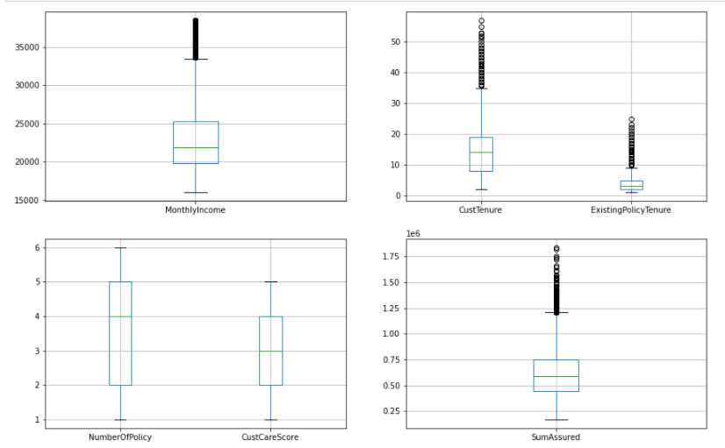
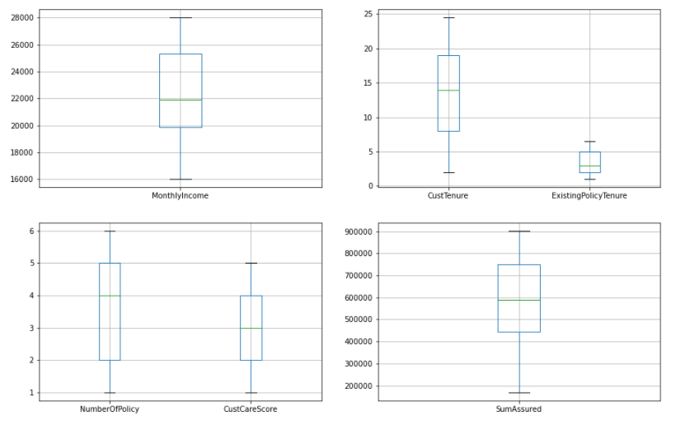
Outlier Treatment
First we check for the outliers and below box plots shows the outliers without treatment
Then we check for the outliers and below box plots shows the outliers with treatment

Slide 13
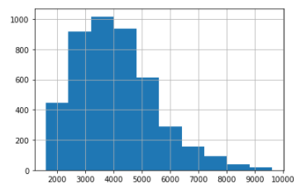
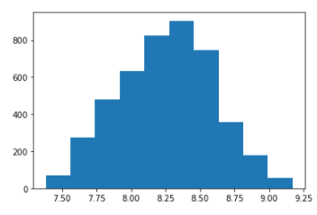
Normality Test of the Continues Variables
To check whether the data is unbalanced, we checked using Shapiro-wilk to test the normality of the continues variables.
The Shapiro-Wilk test for normality is available when using the Distribution platform to examine a continuous variable. The null hypothesis for this test is that the data are normally distributed. If the p-value is greater than 0.05, then the null hypothesis is not rejected.
H0- Data is normal H1 - Data is not normal
The dependent variable was tried to convert into a normal distribution, however the results were still unsuccessful. It will be assumed Normal for further ANNOVA test

Slide 14
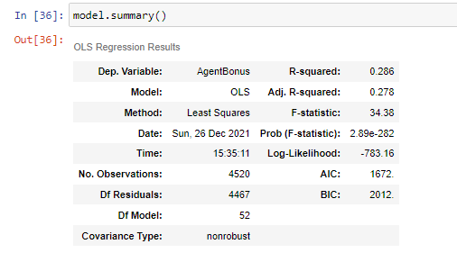
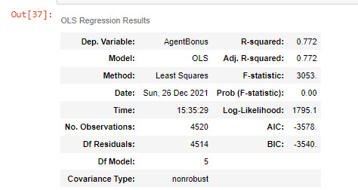
ANNOVA
Standard Errors assume that the covariance matrix of the errors is correctly specified.
The condition number is large, 4.07e+06. This might indicate that there are
Strong multicollinearity or other numerical problems.
Standard Errors assume that the covariance matrix of the errors is correctly specified

Slide 15
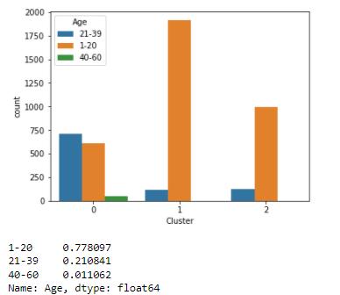
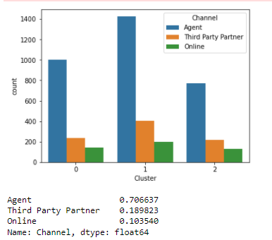
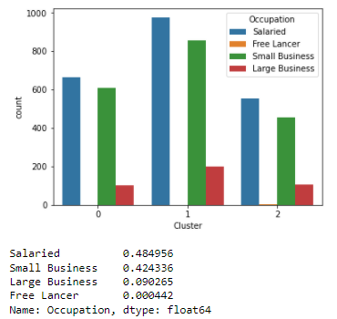
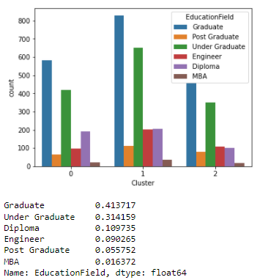
Clustering
We will consider 3 ultimate clusters as that is giving us very fewer negative silhouette widths than 4 clusters
Note: Positive silhouette width suggests that the observation belong to the correct cluster, negative would be opposite.
Below graphs shows the findings with variables VS Clusters

Slide 16
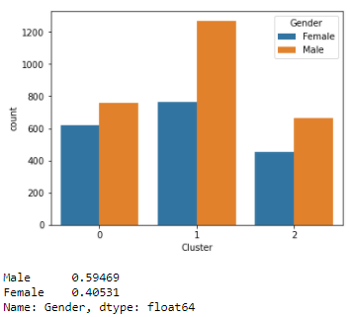
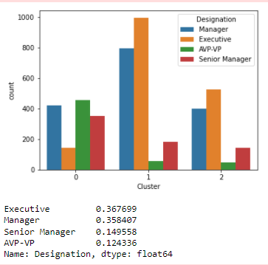
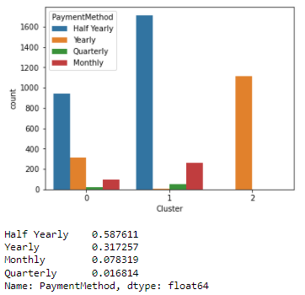
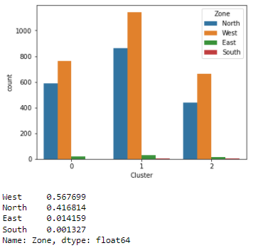
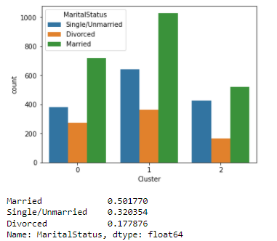
Clustering
We will consider 3 ultimate clusters as that is giving us very fewer negative silhouette widths than 4 clusters
Note: Positive silhouette width suggests that the observation belong to the correct cluster, negative would be opposite.
Below graphs shows the findings with variables VS Clusters

Slide 17
Model Building and Interpretation
Project Approach
We have created multiple models and applied them on different sets of data as required. All the different models which were created were then evaluated using the AUC / F1 score at the end for the testing data set.
Based on this an optimal model was chosen. Eventually we also found the feature importance for the most optimal model.
Models Built
Various tree based as well as distance based models were built as part of this exercise using the different data sets as elaborated earlier.
Model Tuning method
Various model tuning approaches were followed. Primarily we made use of GridSearchCV function with cv = 3 for model hyper parameter tuning.
Also we had to tweak the threshold values to maximize the recall values. Threshold tweaking was required as we had a typical problem of recall precision trade off.
TREE / LINEAR | ENSEMBLE MODELLING | SCALED / UNSCALED
1. We used two data sets. Tree Linear 2.Tree - For Tree based models like CART, Random Forest etc. 3. Linear - For distance based models like Kmeans, LDA etc. | 1. Various ensemble models were also used apart from regular models. 2. Both Bagging and Boosting approaches were tried, evaluated and compared to determine the best model for our purpose. | Some of the models were sensitive to scaling e.g. SVM, KMeans etc. 2. On the other hand we had models like Logit and other tree based models which are scaling agnostic, we used unscaled data set there.
Notes:
Project Approach
The work that we have completed:
We have created multiple models and applied them on different sets of data as required. All the different models which were created were then evaluated using the AUC / F1 score at the end for the testing data set. Based on this an optimal model was chosen. Eventually we also found the feature importance for the most optimal model.
Models Built
Various tree based as well as distance based models were built as part of this exercise using the different data sets as elaborated earlier. These models were built using sklearn and statsmodel libraries. There were various constraints, biggest one being the Type 2 error, which we had to minimize, as bonus variable was the main objective of this exercise. This will discuss in detail later in the report.
Model Tuning method
Various model tuning approaches were followed. Primarily we made use of GridSearchCV function with cv = 3 for model hyper parameter tuning. Also we had to tweak the threshold values to maximize the recall values. Threshold tweaking was required as we had a typical problem of recall precision trade off.
Various different approaches were followed to create multiple models. As mentioned earlier we had created multiple data sets like tree, tree_scaled, tree_smote, tree_smote_scaled, linear, linear_scaled,linear_smote, linear_smote_scaled etc.
We have also creating two generic functions which will be used to evaluate various models and also to tweak their threshold to maximize the recall.
We have created multiple models as part of the Agent bonus prediction. The models include descriptive models like KMeans where we try to segment the gain insights and also predictive classification models like Random Forest, Gradient Boosting model, Logistic regression in order to predict bonus. Combined they can provide prescriptive analysis to the life insurance company and help them with the strategies.
Various permutation and combinations were tried for various models.
We have included the distribution of price at different percentile

Slide 18
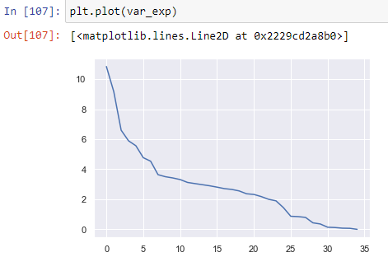
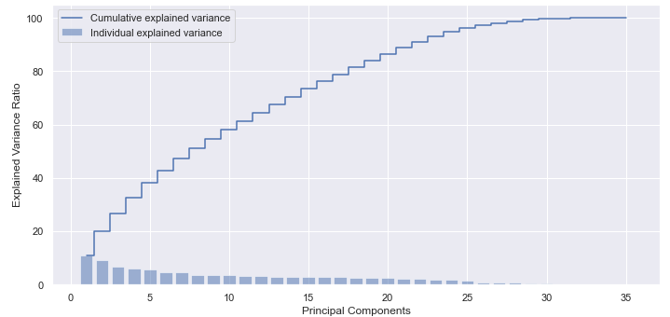
Cumulative Variance
Then using scikit learn PCA. It does all the above steps and maps data to PCA dimensions in one shot
NOTE - we are generating only 4 PCA dimensions (dimensionality reduction from 18 to 4)
Visually we can observe that there is steep drop in variance explained with increase in number of PC's.
We will proceed with 5 components here. But depending on requirement 90% variation or 5 components will also do well.
Cumulative sum of variance explained with [n] features

Slide 19
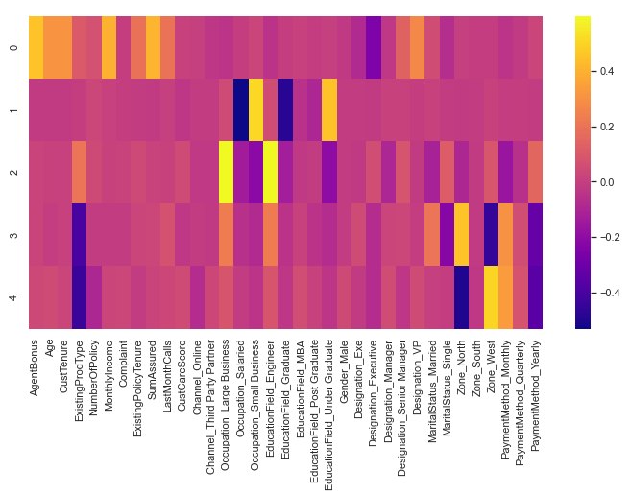
Correlation between the various features and Principal Component
The heat map and the color bar basically represent the correlation between the various features and the principal component itself. Component 2 looks more related to aspect - We can label it as aspect property. Depending on relationship, we could go ahead and label relationship with features

Slide 20
Conclusion – Insights and Recommendation
When Age increases by 1 unit, AgentBonus increases by 23.04 units, keeping all other predictors constant. similarly, when MonthlyIncome increases by 1 unit, AgentBonus increases by 0.03 units, keeping all other predictors constant.
There are also some negative co-efficient values. Occupation_Large_Business has its corresponding co-efficient as -39.31. This implies, when the Occupation is large business, the AgentBonus decreases by 39.31 units, keeping all other predictors constant.
Insights from models, one unit change of a significant feature resulting how much change in bonus.
Delta of coefficients from linear models. Likewise, feature importance of optimum model.
Specific recommendations to up skilling the low performing agents and incentivizing the high performing agents.

Slide 21

Questions

Slide 22


